Slide 1
HOSPITAL DATABASE DESIGN

Slide 2
Team members Adhithyan Rangarajan Ananya Shrivastava Geeta Matta Naveen Ponnaganti Sai Yarra Uday Reddy Vangala
GROUP 7

Slide 3
AGENDA & PROBLEM STATEMENT
The main purpose of this project is to design a database for a hospital in a way that provides seamless access to any required data for a particular patient/disease/treatment to ensure fastest possible data retrieval for all possible business use cases and emergency situations.
This DB provides seamless integration and at the same time has all the required access restrictions to ensure smoothest data transfer, loading, backup and retrieval.
We performed query writing and analytics to filter out results and draw conclusions. We also did performance tuning to optimize our queries so that request can be completed efficiently.
Queries which provide some insights into business use cases such as finding patients who have the same blood group in a zip code space, finding total inventory cost, available number of active beds, emergency services offering hospitals in geographical zone etc.
Data Visualization - Business intelligent decision-making powerful visualizations by using existing data in Tableau.

Slide 4
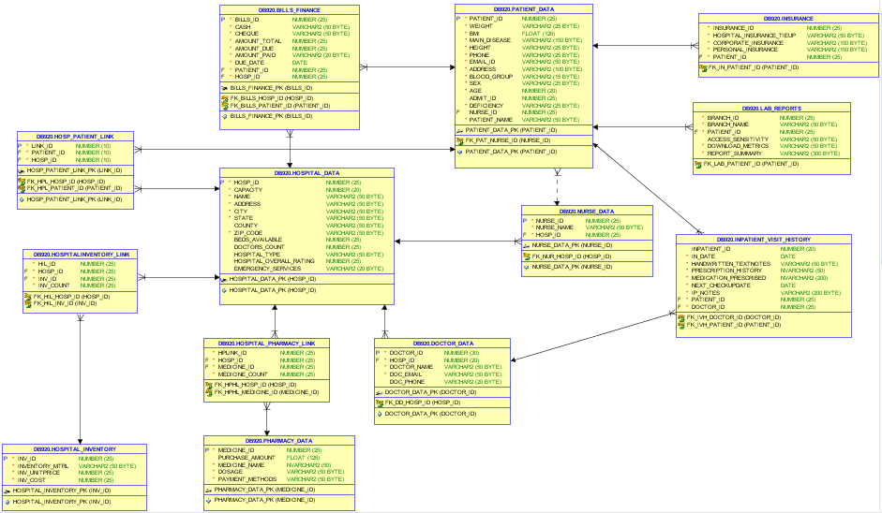
ERD-Oracle SQL-implemented design

Slide 5
Why Oracle Database
We chose Oracle database because of its database management options.
Fast in nature and excellent for structured sensitive healthcare data.
Mostly used for Data Retrieval from a business standpoint.
Huge Data isn’t pushed into the DB in a single shot. Mostly pumped into the DB in chunks and majority work involves retrieval.
Maps nicely to set of business rules and how data is stored in different sectors for different healthcare branches.

Slide 6
BUSINESS RULES
A patient can have multiple lab reports, bills and visit history.
A hospital can have many doctors, nurses and patients
A patient can be assigned to only one nurse, but one nurse can treat multiple patients.
Each hospital will generate many bills based on the patient ID.
Each hospital will have multiple medicines in the pharmacy and same medicine can be found in various hospitals.
Each hospital will have multiple inventory materials in the inventory and same inventory material can be found in various hospitals.
Each patient can have only one insurance associated. Which is identified by insurance ID.

Slide 7
QUERIES – BUSINESS PERSPECTIVE
We came up with the below queries based on an understanding from talking to experts in the healthcare industry and day-to-day business transactions + emergency race cases from a data point of view.
List of patients with their total amount & the due amount which is pending
List the patients above a certain age; grouped on the basis of their location with their name and contact details.
List of hospitals which provide emergency services with a minimum capacity value and particular hospital overall rating.
List of patients who suffer from a particular disease in the same location.

Slide 8
QUERIES – BUSINESS PERSPECTIVE
Details of doctors who treated patients with particular deficiencies.
Total cost of inventory of a particular hospital with a minimum of 3 doctors and number of beds are above 1990.
List of patients and their associated insurance id who owe at least $1800 and the due date is within a particular date range.

Slide 9
DATA VISUALIZATION
The numbers of active doctors in a particular state in the US. We clearly see that California and Florida lead the way.

Slide 10
DATA VISUALIZATION
The total available capacity of the hospitals grouped based on the hospital type countrywide.

Slide 11
DATA VISUALIZATION
A heatmap of the number of patients with multiple diseases by state in the US.

Slide 12
DATA VISUALIZATION
Number of patients in our database at a state level.

Slide 13
DATA VISUALIZATION
The below two visualizations show the number of patients sorted on the basis of their blood group.

Slide 14
DATA VISUALIZATION
Diabetes is one of the most widespread diseases in the US. The below graphic presents the number of patients with diabetes at a state level.

Slide 15
DATA VISUALIZATION
The total inventory cost for each hospital calculated based on the inventory volume and the unit price for the material.

